Slide 1
Chongqing University of Technology
ATAI
Advanced Technique of Artificial Intelligence
Chongqing Unive
Contrast and Generation Make BART a Good Dialogue Emotion Recognizer
（AAAI-2022)
code:https://github.com/whatissimondoing/CoG-BART
Reported by Zhaoze Gao

Slide 2
Chongqing University of Technology
ATAI
Advanced Technique of Artificial Intelligence
Chongqing University of Technology
1. Introduction
2. Approach
3. Experiments

Slide 3
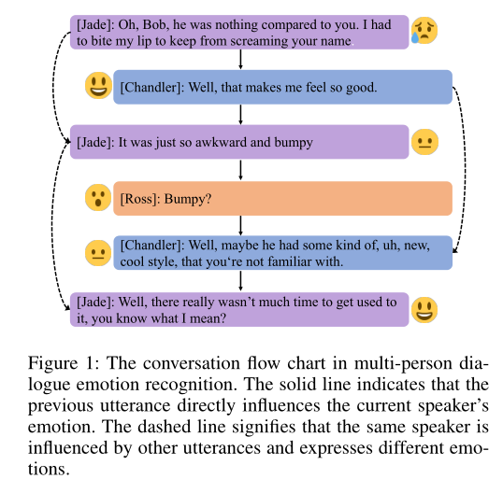
Introduction
three challenges :
• the emotion of each utterance may be affected by contextual information.
• each speaker’s emotion is influenced by the utterance of other speakers in the conversation, so there may exist a sudden change in a speaker’s emotion.
• The third challenge lies in semantically similar but different categories of emotions, such as “frustrated” to “sad”, “happy” to “excited”.

Slide 4
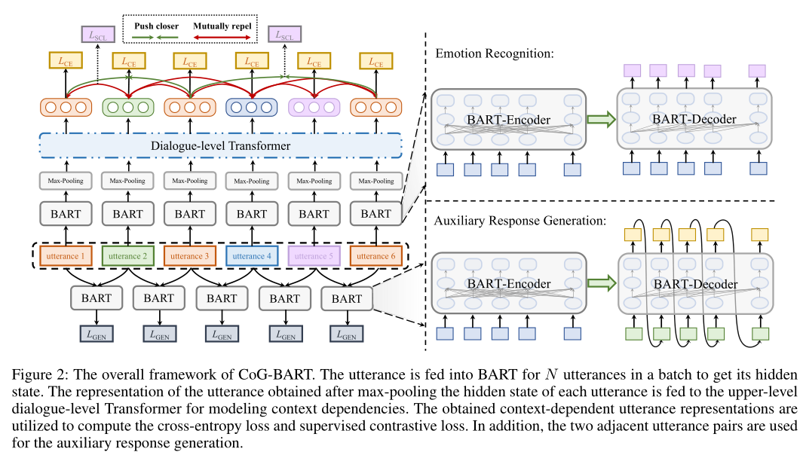
Approach

Slide 5
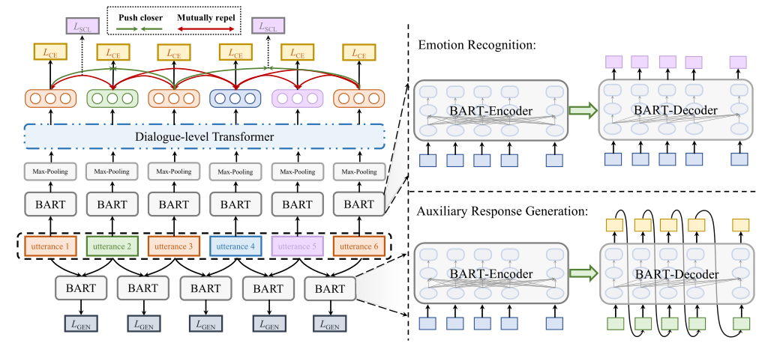
Approach
Utterance Encoding

Slide 6
Approach
Dialogue Modeling

Slide 7
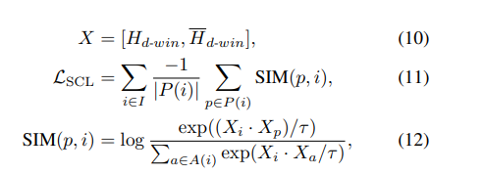
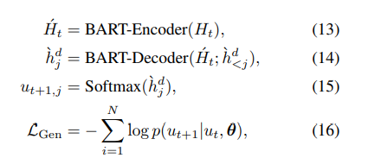
Approach
Supervised Contrastive Learning
Auxiliary Response Generation

Slide 8
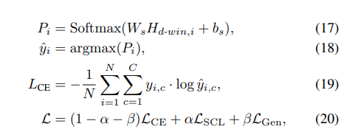
Approach
Model Training

Slide 9
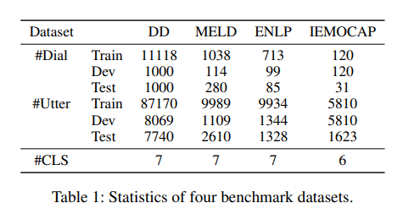
Experiments

Slide 10
Experiments

Slide 11
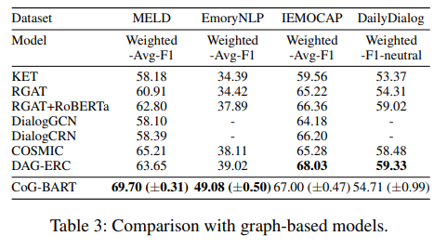
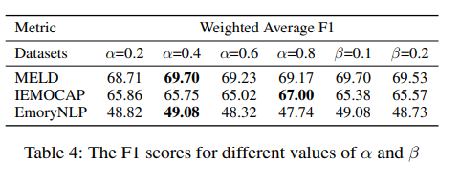
Experiments

Slide 12
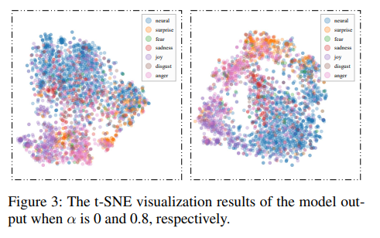
Experiments

Slide 13
Experiments

Slide 14
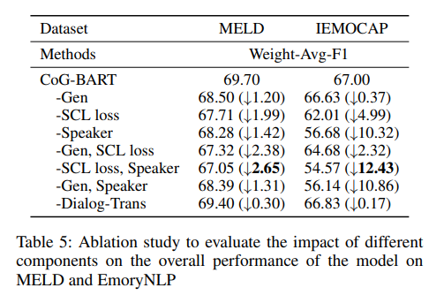
Experiments

Slide 15
Thank you！

